Slide 1

Robert J. Kaiser Middle School
Parent orientation – class of 2029

Slide 2


Introductions
Administrators:
Mrs. Michelle Knowlton, Principal
Dr. Jason Doyle, Assistant Principal
Mrs. Sara Kozachuk, Assistant Principal
School Counselors: Clinical Staff:
Mrs. Jennifer Ducey Mr. Harrison Larkin, Social Worker
Mrs. Brittany Harden-Zaccaria Ms. Sharon Zimmerman, Social Worker
Ms. Laurie Oshinsky Ms. Michelle Cestero, Social Worker
Ms. Jenna Perez Mrs. Jayme Abrams, Psychologist
Guidance Secretary:
Mrs. Maryanne March

Slide 3

How is Middle School Different?
Transitions
Busier Schedules
More Students
More Teachers
More Freedom
Middle school is a challenging time for parents & students. Please use the resources available to you to help your child be a success here at RJK!!

Slide 4
Partnership between School and Families
RJK and our students’ families must have an open dialogue for a successful partnership
Successful family involvement means mutual participation by RJK staff and families
School counselors are the liaisons between the school and families
Each teacher has a built-in conference period every day that can be utilized for parent meetings, either in person or virtually.

Slide 5
Partnership between School and Families (continued)
The role of a School Counselor is to help support students in the areas of academic, social and emotional wellness.
All questions and concerns surrounding academics should be directed to the teacher. This can be accomplished through email, phone, in-person or online conferences.
Counselors are assigned to a grade and follow the students throughout their time at RJK from 6th through 8th grade.

Slide 6
Where students and families should direct their concerns:
  Guidance Office: academic, social and emotional needs
  Nurse’s Office: medical needs
  Assistant Principals’ Office: student discipline and attendance concerns
  Main Office: Overall building supervision, including curriculum and instruction, by the principal

Slide 7
GUIDANCE:
How and when to utilize us!
You have a need for social/emotional support
You have academic and/or scheduling questions
Naviance for early college and career exploration
Sign-up for after school tutorials
Families can schedule team meetings through the guidance secretary, Mrs. March by contacting her at (845) 796-3058 extension 3

Slide 8
Scheduling: what to expect
A,B Daily rotation
9 periods in a day
Lunch
WIN (What I Need)for tier 2 academic intervention
Exploratory classes (Art, Home & Careers, Health, Music, World Cultures, STEAM, PE)
Five 2-Teacher Teams
2 Reading and math interventions
Band/Chorus/Orchestra
Elective courses and Excelsior

Slide 9
A Day in the Life at RJK
Arrival (Tentatively 7:09 am)
Grab and Go Breakfast
Homeroom (7:09-7:24)
Periods 1-9
Dismissal (2:15 pm)
Bussing
After School Tutorials and Activities

Slide 10
A day at RJK
Students coming by bus enter through the student entrance. Those dropped off by car are released from the auditorium.
Pick up grab and go breakfast.
7:09am – Homeroom begins. Students are in homeroom for 15 minutes (one hour on mindfulness Mondays) before starting period 1.
If a student arrives late, they must sign in at the Assistant Principal’s office.
2:15- Dismissal bell
Dismissal for students is staggered. Announcements are made for those being picked up, those walking home, those taking a bus and those students playing sports or staying for an after school activity.
Students go directly to their buses, pick up location, or the cafeteria if staying after.
Students may sign up for after school activities with the respective advisor. Modified sports are not available to 6th grade students.
4:45pm buses are available most days.

Slide 11
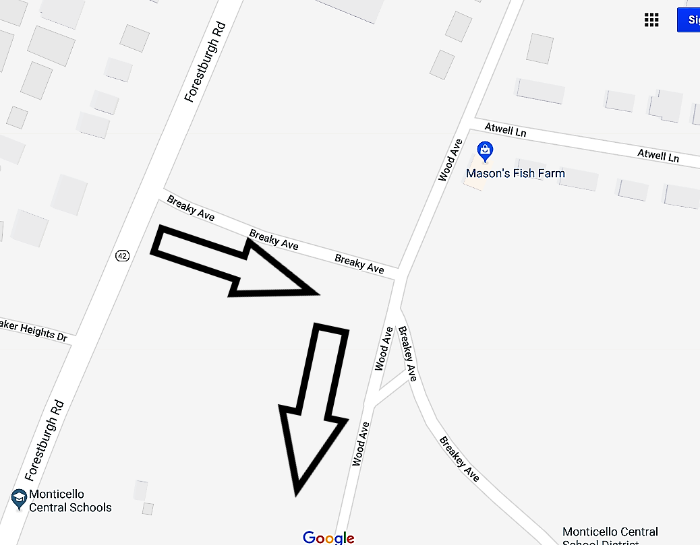
Drop off procedures
BUS GARAGE
When dropping your child off at school, you will pull into the lower HS parking lot near the fields. Students will enter through the auditorium and come to the middle school.
BASEBALL

Slide 12
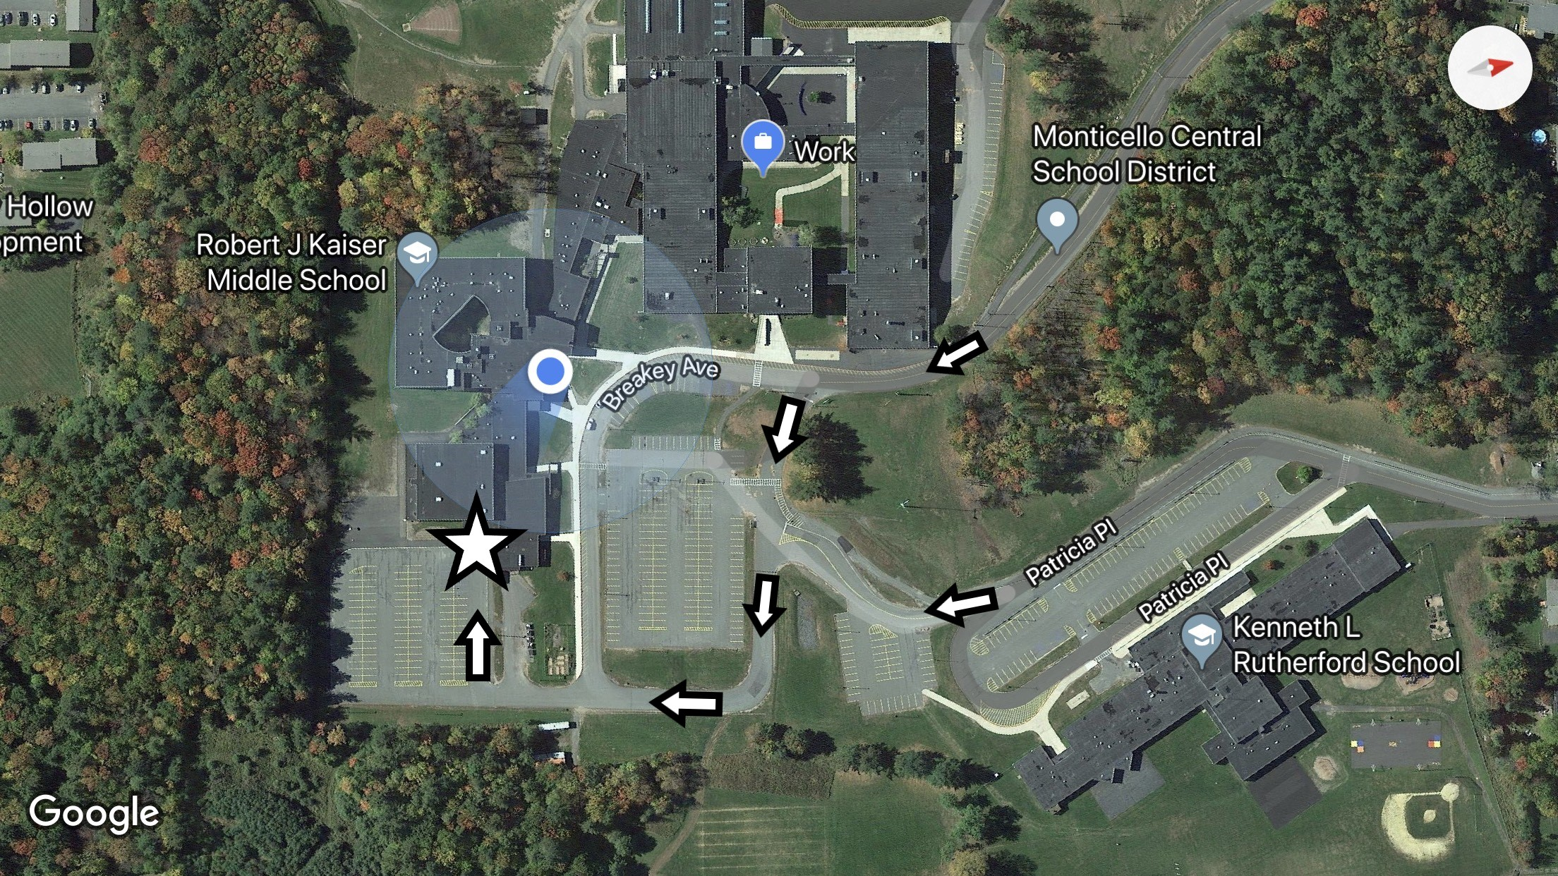
PICK UP PROCEDURES
To avoid the busses, enter via the Rutherford driveway. Make a left at the stop sign and travel to the back of the middle school.

Slide 13

Expectations
Come to school! Attendance matters!
Be to class on time
3-minute passing time
Use technology appropriately
Be kind
Ask for help
Dress appropriately
Follow directions

Slide 14
Attendance
State Ed defines chronic absenteeism as 10% absentee rate.
In a 180 day school year that equates to 18 days.
To put this in perspective a student who misses two days per month in grades K-12 will miss the equivalent of 260 days or a year and a half of school over the course of their schooling.
This gap in learning will have long lasting impacts on student performance and more so graduation rates.
Staff and student presence are paramount to intellectual stimulation and growth.

Slide 15
Safety and Security
Drills are conducted according to state regulations
  Evacuations
  Lockdown
  Lockout
  Hold in place
5 safety staff members
  Help with day-to-day logistics of moving students to where they need to be
  Help supervise lunch periods
  Stationed at various locations throughout the building
School Resource Officer (shared with the High School)
To pick up your child:
  You must present safety staff with valid ID at the front desk
  Only adults listed on the contact list will be allowed to pick up your child

Slide 16
Save These Dates!
RJK 6th Grade Academy Boot Camp
  August 8th and 9th for students with last names beginning with A-K
  August 10th and 11th for students with last names beginning with L-Z
  9:00-2:15 each day
  Transportation provided
  Breakfast and Lunch Provided
First day of school is on September 6, 2022

