Slide 1

Long Range Financial Plan
November 2021
Lisa Failla, Assistant Superintendent for Business

Slide 3
District Summary
Our Vision:
This Board aspires to build a world-class community of schools and be a district of choice.
Our Mission:
This Board’s mission is to ensure that each learner is future-ready by providing empowering educational experiences.
Our Goals:
Student Success – This Board will provide a holistic education comprised of extensive curricular and extra-curricular experiences that empower each individual student to conquer challenges, develop talents, and discover passions, while sustaining rigor and achieving evidence-based academic growth.
Community Engagement – This Board will strive to build authentic relationships rooted in trust, transparency, and two-way communication with all constituents. We will actively seek avenues to partner with local organizations and agencies to increase our network of resources to improve and support life-long learning opportunities for our community.
School Culture – This Board will foster an inclusive culture that sparks community pride, emphasizes kindness and respect and ensures that all students, staff and visitors are valued and supported in safe, secure, orderly and clean appropriately effective facilities.
Fiscal Responsibility – This Board will fortify its financial assets through long-term strategic planning that aims to consistently maximize district improvements while minimizing taxpayer impact.

Slide 4
Purpose of Long-Range Financial Planning
Fiscal stability and responsibility are critical aspects to ensure the success of any school district. By creating and continually updating a five-year financial plan, the Monticello Central School District has a clearer picture of how the decisions that are made today can impact the District’s financial future. Financial planning allows the district to be in a better position to sustain and add to instructional programs and other opportunities for our students. The long-range plan takes into account factors such as instructional mandates, salaries, benefits, tuitions, utilities and technology to name a few.

Slide 5
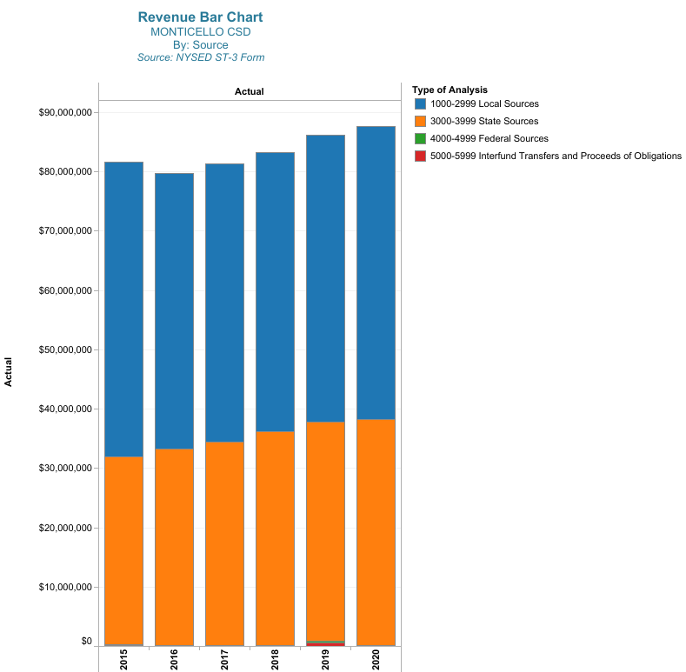
Revenue History
Revenue History by Source
This chart outlines Monticello CSD’s historic revenue sources. Revenue from state and local sources make up the majority of the revenue in the budget.
State sources include state aid, building aid and any other state funding.
Local sources include the tax levy, payments in lieu of taxes, interest earnings, rental of property, BOCES refund and other miscellaneous sources of funding.

Slide 6
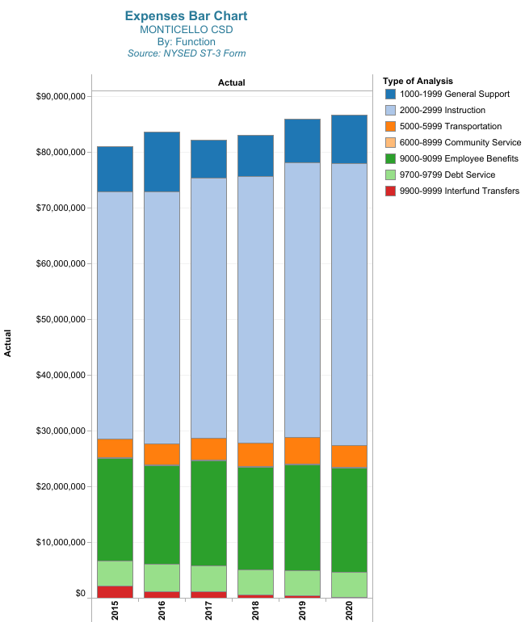
Expenditure History
Expenditure History by Function
This chart outline Monticello CSD’s expenditure history. Instructional expenditures are the majority of the budget, which includes instructional salaries.

Slide 7
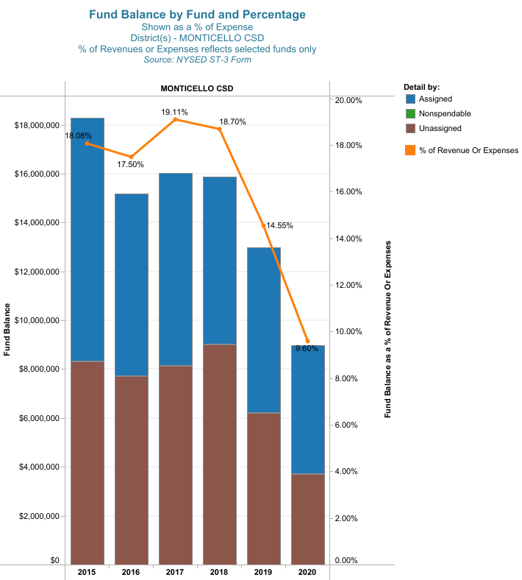
Fund Balance History
This chart shows the District’s fund balance. The Monticello Central School District has reduced its unassigned fund balance by 65%. Assigned fund balance is mainly the Capital Project Reserve approved by the voters in May 2015 and 2019 and the other reserves for specific purposes (see the District’s reserve plan)
The unassigned fund balance can be used to balance the budget and reduce the tax levy. Continued use of fund balance for budgeting purposes is not sustainable and can place the District in a difficult financial position in the future.

Slide 8
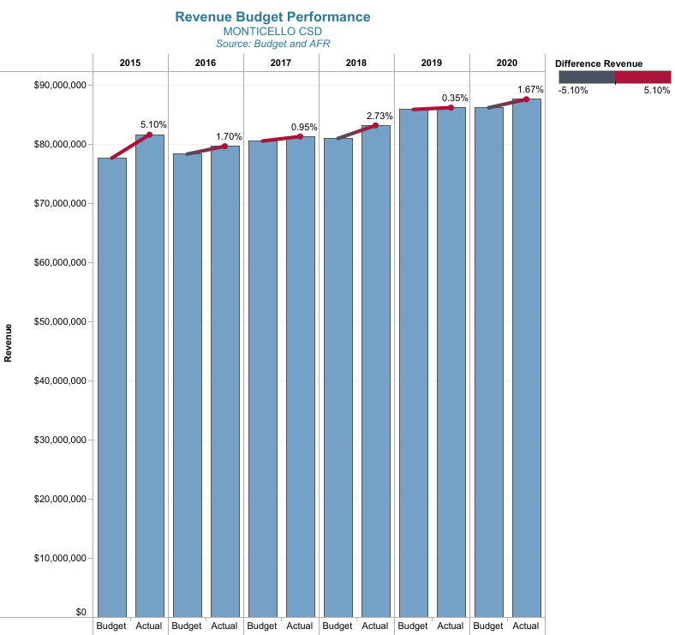
Budget to Actual
Revenue Budget to Actual
This charts show the amount budgeted for revenue and the actual revenue for each school year. For the last 4 years, revenue on average is within 1.4% of the budgeted amount.

Slide 9
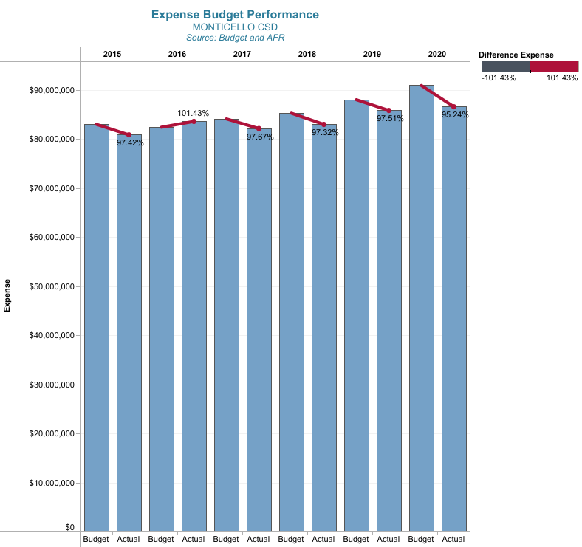
Budget to Actual
Expenditure Budget to Actual
This chart shows the amount budgeted for expenditures compared to actual expenditures. For the last four years, on average expenditures are within 2.8% of the budget.

Slide 10
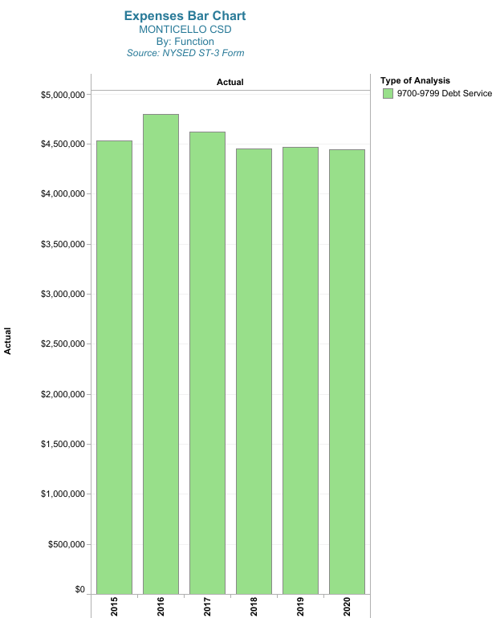
Debt Service
The term “debt service” refers to the amount of debt a school district has on its books as a result of financing capital/building construction projects. Similar to a residential mortgage, school districts oftentimes finance larger capital improvement projects. Unlike a mortgage, school districts receive additional state revenue know as “Building Aid” to help pay for these projects. Each district in the state has an assigned building aid ratio which determines how much state aid it will receive on each project. Monticello’s building aid ratio is approximately 60%, which means for every dollar spent on qualifying capital construction work, the state will reimburse the district $.60. This aid ratio changes every year, but on average it has remained at 60%. The current capital improvement project ($54 million) has not been converted to bonds yet. Payments on the Bond Anticipation notes issues for this project are included in this chart.

Slide 11
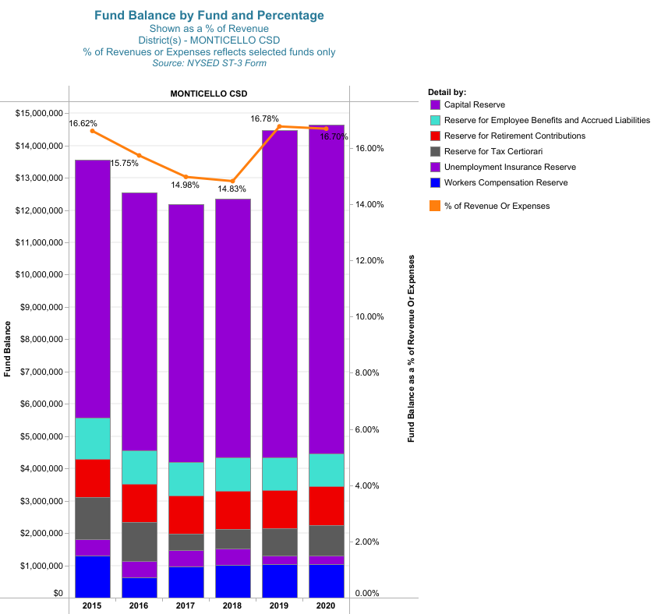
Reserves
Reserves are similar to savings accounts in that, reserves allow district to set aside money for specific contingencies or purposes.
The types of reserves are authorized by law and the funding and use of each is also determined by statue.
The Board of Education has adopted a Reserve Plan that details each authorized reserve and the appropriate use of each.
This charts shows the reserve funds the district currently utilizes. The largest reserve is the Capital Reserve which was authorized by the voters in 2015 and 2019.

Slide 12
Five Year Financial Plan
Key Factors
All assumptions are made at a single point in time. These factors can and will change over time but provide a basis for financial decision making. Usually, this plan will be updated annually in January or February.
First year projections are based primarily on the District’s rollover budget, carrying forward all current expenses. No adjustments have been made to staffing or programming.
The forecast of revenues and expenditures are for five years. A longer time frame is less reliable and increasingly speculative.

Slide 13
Assumptions
Revenue Projections
An increase in state aid revenue based on the 2021-22 state budget, excluding BOCES and building aid. Categorical Aids have not increased in several years and this projection continues that trend.
An average increase of 1.2% on the tax levy. Capital exclusions will impact the levy once the current project has been bonded.
Appropriated fund balance has been reduced to a more sustainable figure.
BOCES refund has been projected to be stable for the next 5 years
 | General (A) Fund │ Revenue Analysis
 | 5 year projection -2
 |  |  | BUDGET | REVENUE PROJECTIONS
 |  |  | 2021 | 2022 | %∆ | 2023 | %∆ | 2024 | %∆ | 2025 | %∆ | 2026 | %∆
 | LOCAL
 | Property Taxes |  | $44,493,025 | $43,576,655 | -2.06% | $44,060,200 | 1.11% | $44,549,103 | 1.11% | $45,038,339 | 1.10% | $45,532,961 | 1.10%
 | Other Local Revenue |  | 4,892,084 | 5,331,625 | 8.98% | 5,106,625 | -4.22% | 4,996,625 | -2.15% | 4,896,625 | -2.00% | 4,796,625 | -2.04%
 | TOTAL LOCAL REVENUE |  | 49,385,109 | 48,908,280 | -0.97% | 49,166,825 | 0.53% | 49,545,728 | 0.77% | 49,934,964 | 0.79% | 50,329,586 | 0.79%
 | STATE
 | Basic Aid |  | 31,358,841 | 34,484,910 | 9.97% | 35,864,306 | 4.00% | 36,940,236 | 3.00% | 37,679,040 | 2.00% | 38,432,621 | 2.00%
 | Other State Revenue |  | 5,901,977 | 5,901,977 | 0.00% | 5,901,977 | 0.00% | 5,901,977 | 0.00% | 5,901,977 | 0.00% | 5,901,977 | 0.00%
 | TOTAL STATE REVENUE |  | 37,260,818 | 40,386,887 | 8.39% | 41,766,283 | 3.42% | 42,842,213 | 2.58% | 43,581,017 | 1.72% | 44,334,598 | 1.73%
 | TOTAL FEDERAL REVENUE |  | 250,000 | 250,000 | 0.00% | 250,000 | 0.00% | 250,000 | 0.00% | 250,000 | 0.00% | 250,000 | 0.00%
 | OTHER FINANCING SOURCES |  | 937,098 | 0 | ####### | 0 |  | 0 |  | 0 |  | 0
 | TOTAL REVENUE |  | $87,833,025 | $89,545,167 | 1.95% | $91,183,108 | 1.83% | $92,637,941 | 1.60% | $93,765,981 | 1.22% | $94,914,184 | 1.22%

Slide 14
Tax Levy Limit Projection
The Tax Levy Limit, commonly referred to as the “tax cap”, imposes a limit on the amount of taxes a school district can levy in a given year.
Although 2% is most often associated with the “tax cap”, there are many other factors, specifically exclusions, that are part of the tax levy limit formula.
Exclusions adjust the overall levy limit and can add or reduce to the total potential amount levied as outlined below.
For the Monticello Central School District, PILOTs (Payments in lieu of taxes) and the Capital Exclusion have an impact on the tax levy limit. This is the current 2021-2022 tax levy limit calculation and the projected limit for the next 4 years.
Modest assumptions are made in both the Tax Base Growth Factor and the Allowable Growth Factor.
Tax Cap Calculator Results Report
5 year projection
 |  | BUDGET | PROJECTIONS
 |  | 2021 | 2022 | 2023 | 2024 | 2025 | 2026
 | Tax Levy Limit Before Adjustments and Exclusions
 | Prior FYE Tax Levy | $44,493,025 | $44,493,025 | $43,576,655 | $44,060,200 | $44,549,103 | $45,038,339
 | Tax Cap Reserve Plus Interest from Two Years Ago Used to Reduce Previous Year | $0 | $0 | $0 | $0 | $0 | $0
 | Total Tax Cap Reserve Amount (including interest earned from Prior FYE) | $0 | $0 | $0 | $0 | $0 | $0
 | Tax Base Growth Factor | 1.0098 | 1.0060 | 1.0010 | 1.0010 | 1.0010 | 1.0010
 | PILOTs Receivable from Prior FYE | $2,358,939 | $2,236,417 | $2,235,000 | $2,230,000 | $2,225,000 | $2,225,000
 | Tort Exclusion Amount Claimed in Prior FYE | $0 | $0 | $0 | $0 | $0 | $0
 | Capital Levy for Prior FYE | $2,467,321 | $2,350,850 | $2,350,000 | $2,350,000 | $2,350,000 | $2,350,000
 | Allowable Growth Factor | 1.0123 | 1.0100 | 1.0100 | 1.0100 | 1.0100 | 1.0100
 | PILOTS Receivable for Current FYE | $2,236,417 | $2,235,000 | $2,230,000 | $2,225,000 | $2,225,000 | $2,225,000
 | Available Carryover from Prior FYE | $0 | $0 | $0 | $0 | $0 | $0
 | Total Levy Limit Before Adjustments and Exclusions | $43,135,552 | $42,857,006 | $41,710,284 | $42,199,103 | $42,688,339 | $43,182,961
 | Exclusions
 | Tax Levy Necessary for Expenditures Resulting from Tort Judgements Over 5% | $0 | $0 | $0 | $0 | $0 | $0
 | Capital Levy for Current FYE | $2,350,850 | $2,350,000 | $2,350,000 | $2,350,000 | $2,350,000 | $2,350,000
 | ERS contribution increase greater than 2% | $0 | $0 | $0 | $0 | $0 | $0
 | TRS contribution increase greater than 2% | $0 | $0 | $0 | $0 | $0 | $0
 | Total Exclusions | $2,350,850 | $2,350,000 | $2,350,000 | $2,350,000 | $2,350,000 | $2,350,000
 | Tax Levy Limit, Adjusted For Transfers, Plus Exclusions | $45,486,402 | $45,207,006 | $44,060,284 | $44,549,103 | $45,038,339 | $45,532,961
 | Total Tax Cap Reserve Amount Used to Reduce Current FYE Levy | $0 | $0 | $0 | $0 | $0 | $0
 | Current FYE Proposed Levy, Net of Reserve | $44,493,025 | $43,576,655 | $44,060,200 | $44,549,103 | $45,038,339 | $45,532,961
 | OR Current FYE Proposed Levy, Net of Reserve % | 0.00% | 0.00% | 0.00% | 0.00% | 0.00% | 0.00%
 |  | 2021 | 2022 | 2023 | 2024 | 2025 | 2026
 | CURRENT FYE PROPOSED LEVY, $ entry | $44,493,025 | $43,576,655 | $44,060,200 | $44,549,103 | $45,038,339 | $45,532,961
 | CURRENT FYE PROPOSED LEVY, % entry | $0 | $0 | $0 | $0 | $0 | $0
 | CURRENT FYE PROPOSED LEVY, NET OF RESERVE % | 0.00% | -2.06% | 1.11% | 1.11% | 1.10% | 1.10%
 | TAX LEVY LIMIT % | 2.23% | 1.60% | 1.11% | 1.11% | 1.10% | 1.10%
 | DIFFERENCE BETWEEN TAX LEVY LIMIT AND PROPOSED LEVY | $993,377 | $1,630,351 | $84 | ($0) | ($0) | $0
 | YEAR OVER YEAR CHANGE IN CURRENT FYE PROPOSED LEVY | $0 | ($916,370) | $483,545 | $488,903 | $489,236 | $494,622

Slide 15
Expenditure Projections
Assumptions
Salaries and Benefits make up the largest portion of the General Fund Budget. BOCES Services are also a large portion. The following assumptions were used to project expenditures for the next four (4) years.
Salary increases range from 2% to step increment plus 2%. Contracts currently under negotiations may have an additional impact on future year salary increases
Benefit increases include: 5% increase in health insurance costs, retirement system contribution remain flat
Debt service on the voter approved $54 million dollar Capital Improvement project
 | General (A) Fund │ Expenditure Analysis
 | 5 year projection -2
 |  |  | BUDGET | EXPENDITURE PROJECTIONS
 |  |  | 2021 | 2022 | %∆ | 2023 | %∆ | 2024 | %∆ | 2025 | %∆ | 2026 | %∆
 | Salaries |  | $38,736,282 | $39,384,564 | 1.67% | $40,152,579 | 1.95% | $40,935,955 | 1.95% | $41,734,999 | 1.95% | $42,550,023 | 1.95%
 | Benefits |  | 20,378,214 | 20,342,851 | -0.17% | 20,953,137 | 3.00% | 21,581,731 | 3.00% | 22,229,183 | 3.00% | 22,896,058 | 3.00%
 | TOTAL SALARIES & BENEFITS |  | 59,114,496 | 59,727,415 | 1.04% | 61,105,716 | 2.31% | 62,517,686 | 2.31% | 63,964,181 | 2.31% | 65,446,081 | 2.32%
 | Equipment and Capital Outlay |  | 661,500 | 661,500 | 0.00% | 661,500 | 0.00% | 661,500 | 0.00% | 661,500 | 0.00% | 661,500 | 0.00%
 | Contractual, Supplies and Other |  | 25,231,097 | 25,438,232 | 0.82% | 26,010,592 | 2.25% | 26,595,831 | 2.25% | 27,194,237 | 2.25% | 27,806,107 | 2.25%
 | Supplies |  | 2,285,043 | 2,310,623 | 1.12% | 2,310,623 | 0.00% | 2,310,623 | 0.00% | 2,310,623 | 0.00% | 2,310,623 | 0.00%
 | Debt Service Principal |  | 2,678,244 | 2,566,191 | -4.18% | 2,566,191 | 0.00% | 2,566,191 | 0.00% | 2,566,191 | 0.00% | 2,566,191 | 0.00%
 | Debt Service Interest |  | 287,645 | 287,645 | 0.00% | 287,645 | 0.00% | 287,645 | 0.00% | 287,645 | 0.00% | 287,645 | 0.00%
 | Interfund Transfers |  | 275,000 | 275,000 | 0.00% | 275,000 | 0.00% | 275,000 | 0.00% | 275,000 | 0.00% | 275,000 | 0.00%
 | TOTAL ALL OTHER |  | 31,418,529 | 31,539,191 | 0.38% | 32,111,551 | 1.81% | 32,696,790 | 1.82% | 33,295,196 | 1.83% | 33,907,066 | 1.84%
 | TOTAL EXPENDITURES |  | $90,533,025 | $91,266,606 | 0.81% | $93,217,267 | 2.14% | $95,214,476 | 2.14% | $97,259,377 | 2.15% | $99,353,147 | 2.15%

Slide 16
General Fund Projection Summary
The General Fund Projection Summary shows a deficit each year as part of the financial plan. This deficit decreases over time and represents the district’s commitment to budgeting practices that do not generate large fund balances.
Each year as actual revenue and expenditure are known, these tables will be updated to show the Monticello Central School District’s current financial situation.
General (A) Fund │ Projection Summary
5 year projection -2
 |  | BUDGET | REVENUE / EXPENDITURE PROJECTIONS
 |  | 2021 | 2022 | %∆ | 2023 | %∆ | 2024 | %∆ | 2025 | %∆ | 2026 | %∆
REVENUE
Local |  | $49,385,109 | $48,908,280 | -0.97% | $49,166,825 | 0.53% | $49,545,728 | 0.77% | $49,934,964 | 0.79% | $50,329,586 | 0.79%
State |  | 37,260,818 | 40,386,887 | 8.39% | 41,766,283 | 3.42% | 42,842,213 | 2.58% | 43,581,017 | 1.72% | 44,334,598 | 1.73%
Federal |  | 250,000 | 250,000 | 0.00% | 250,000 | 0.00% | 250,000 | 0.00% | 250,000 | 0.00% | 250,000 | 0.00%
Transfers / Other |  | 937,098 | 0 | -100.00% | 0 |  | 0 |  | 0 |  | 0
TOTAL REVENUE |  | 87,833,025 | 89,545,167 | 1.95% | 91,183,108 | 1.83% | 92,637,941 | 1.60% | 93,765,981 | 1.22% | 94,914,184 | 1.22%
EXPENDITURES
Salary and Benefit Costs |  | 59,114,496 | 59,727,415 | 1.04% | 61,105,716 | 2.31% | 62,517,686 | 2.31% | 63,964,181 | 2.31% | 65,446,081 | 2.32%
Other |  | 31,418,529 | 31,539,191 | 0.38% | 32,111,551 | 1.81% | 32,696,790 | 1.82% | 33,295,196 | 1.83% | 33,907,066 | 1.84%
TOTAL EXPENDITURES |  | 90,533,025 | 91,266,606 | 0.81% | 93,217,267 | 2.14% | 95,214,476 | 2.14% | 97,259,377 | 2.15% | 99,353,147 | 2.15%
SURPLUS / DEFICIT |  | (2,700,000) | (1,721,439) |  | (2,034,159) |  | (2,576,535) |  | (3,493,396) |  | (4,438,963)
BEGINNING FUND BALANCE |  | 26,388,586 | 23,688,586 |  | 21,967,147 |  | 19,932,988 |  | 17,356,453 |  | 13,863,057
PROJECTED YEAR END BALANCE |  | $23,688,586 | $21,967,147 |  | $19,932,988 |  | $17,356,453 |  | $13,863,057 |  | $9,424,094
FUND BALANCE AS % OF EXPENDITURES |  | 26.17% | 24.07% |  | 21.38% |  | 18.23% |  | 14.25% |  | 9.49%
FUND BALANCE AS # OF MONTHS OF EXPEND. |  | 3.14 | 2.89 |  | 2.57 |  | 2.19 |  | 1.71 |  | 1.14

